Slide 1

Steps To Build
EUA App

Slide 2


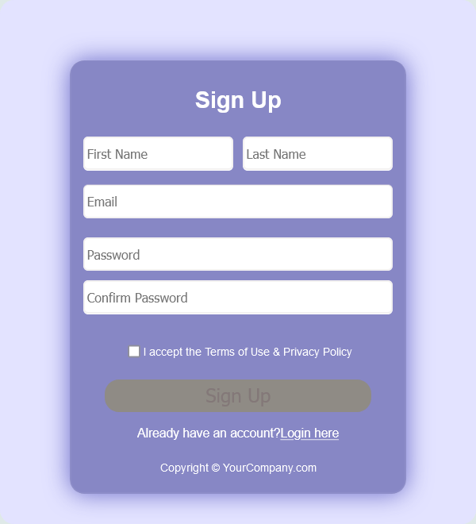
Sign Up / Sign In with PHR
Address :
Users begin their journey by creating an account
or signing in with their
Personal Health Record (PHR) address.
This process ensures that their
health information is securely linked to their profile,
allowing for easy access and management of their medical data.

Slide 3

Select a UHI Service:
Once logged in, users can browse and select from various
Universal Health Interface (UHI) services.
This selection process allows them to choose
specific medical services
tailored to their needs, whether it’s a consultation,
diagnostic service, or wellness check.

Slide 4
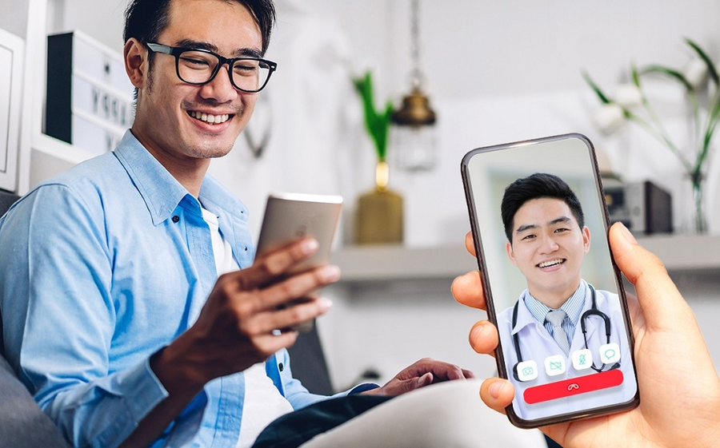
Teleconsultations:
Teleconsultations offer users the convenience
of receiving medical advice remotely.
Through video calls, patients can connect
with healthcare professionals without the
need for in-person visits,
making healthcare more accessible and efficient.

Slide 5

Search HSPAs for Doctor:
To find the right healthcare provider,
users can
search for healthcare service
providers (HSPAs) by
specifying criteria such as
specialty or location.
This feature helps them
find qualified doctors
who best match their healthcare needs.

Slide 6


Display Search Results:
After conducting a search, the app displays a list of
available doctors or facilities that meet the user’s criteria.
This streamlined process
makes it easy for users to
compare options and choose a provider that suits them.

Slide 7

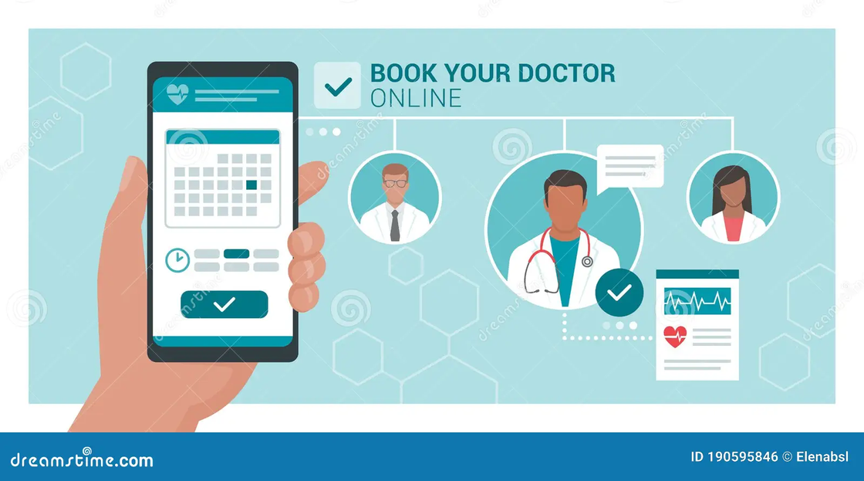
Book Selected Doctor/Facility:
Once users have found a suitable doctor or facility,
they can easily book an appointment
through the app.
This straightforward booking process
enhances user
experience by minimizing
the hassle
often associated with scheduling healthcare appointments.

Slide 8
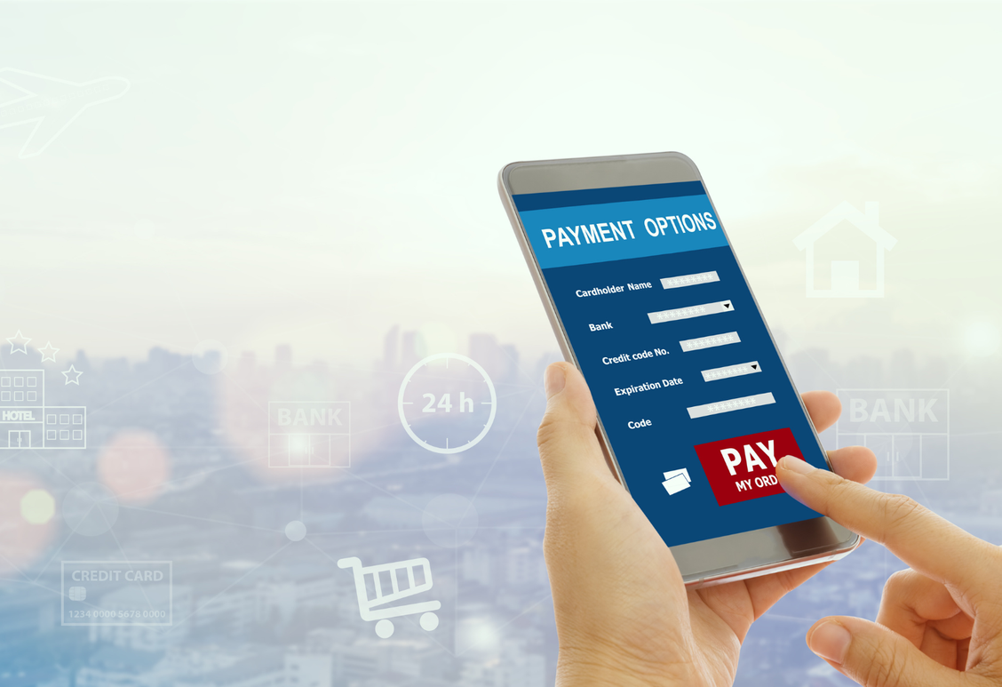
Collect Payment if Required:
If the service requires a fee, the app securely
handles payment processing.
This ensures that users can
complete their
bookings seamlessly without needing
to deal with external payment systems.

Slide 9
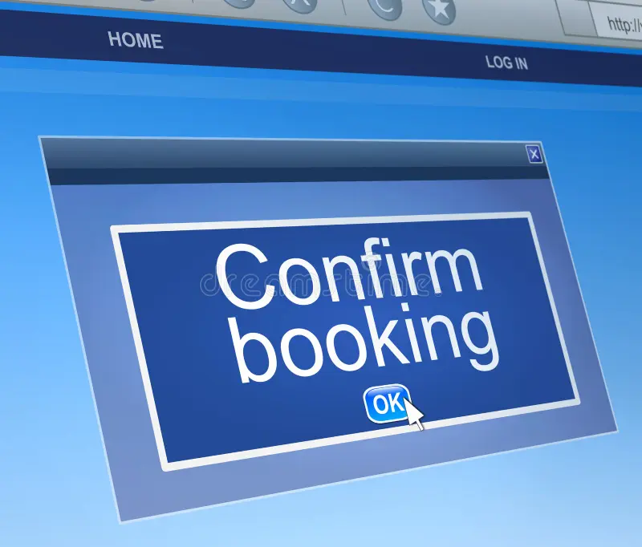
Confirm Booking:
After a successful booking, users receive a confirmation
notification detailing their appointment.
This reassurance helps them feel confident
about their scheduled visit and ensures they
have the necessary information at hand.

Slide 10

Exchange Messages with Doctor& Share Health Records:
The app includes a secure messaging feature
that allows users to communicate directly with their healthcare providers.
This functionality enables patients
to ask follow-up questions or clarify
any concerns they may have about their health or treatment.
Users have the ability to share their health
records with their chosen doctor easily. This feature ensures
that healthcare providers have access to pertinent medical history,
facilitating more informed decision-making during consultations.

Slide 11

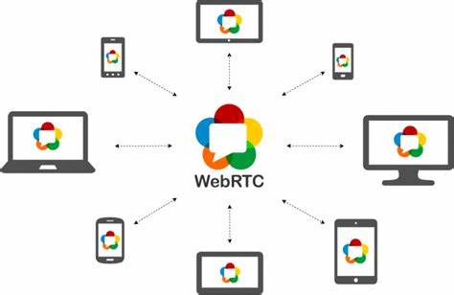
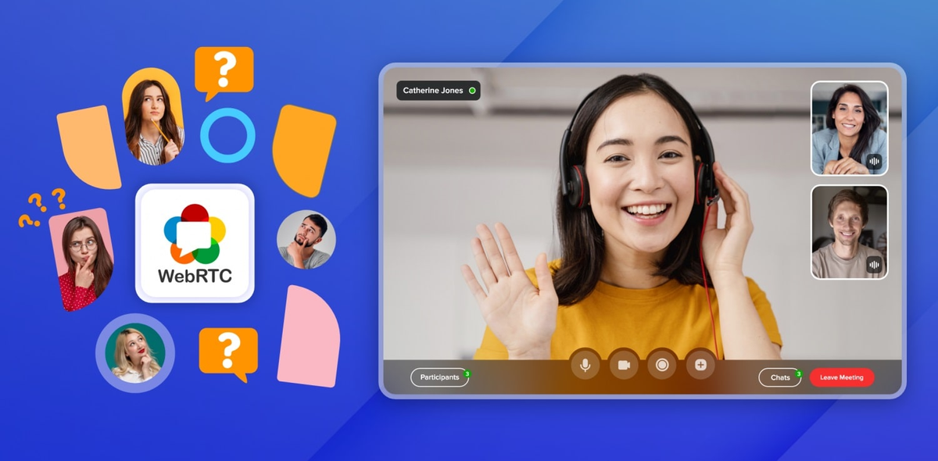
Setup WebRTC for Teleconsults & Initiate Call for Teleconsults:
To enable seamless video communication during teleconsultations, the app utilizes WebRTC technology. This setup allows for high-quality, real-time video calls, ensuring that patients and doctors can connect effectivelly.
At the scheduled time of their appointment, users can initiate a video call with their healthcare provider directly from the app. This convenient feature helps streamline the consultation process, making it easy to receive care.

Slide 12
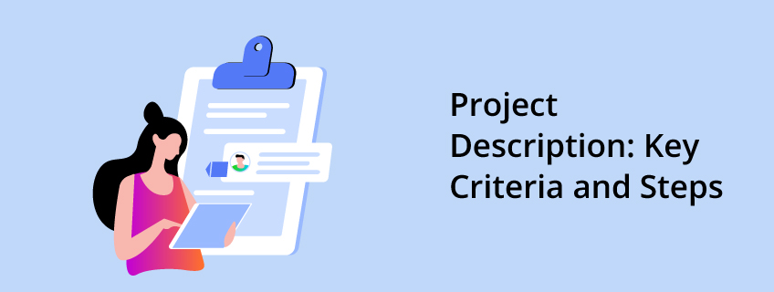
Get Final Prescription:
Following a consultation, users can receive their prescriptions
digitally through the app. This feature allows for easy
access to medications and the ability to share
prescriptions with pharmacies without hassle.

Slide 13
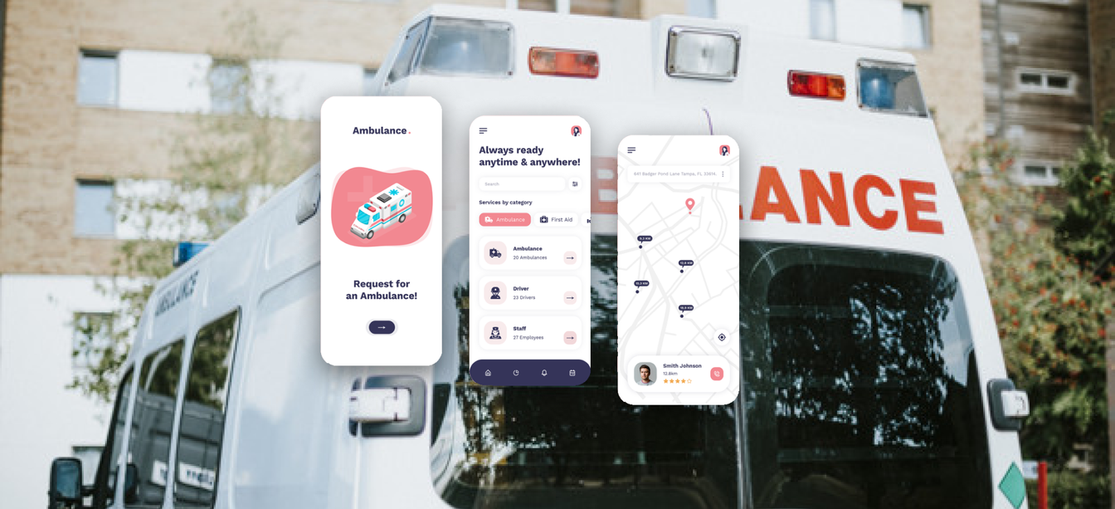
Ambulance Booking:
In emergencies, users can book ambulance services
directly through the app. This feature enhances
accessibility to urgent care, ensuring that
help is just a few taps away when it’s needed most.

Slide 14


